Slide 1
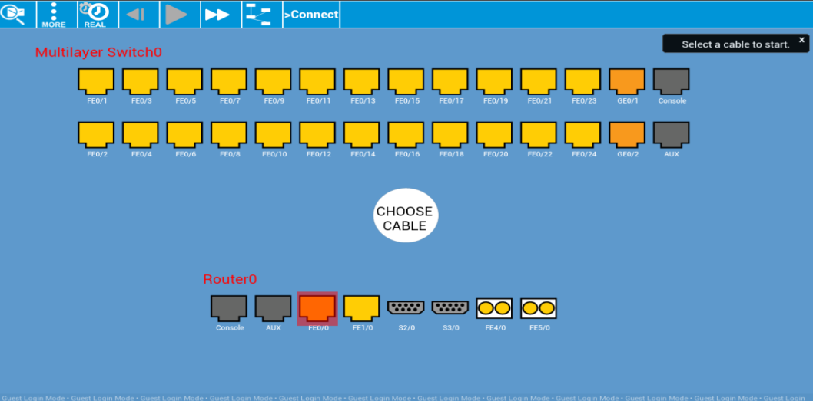


Cisco Packet Tracer Mobile 2.0 (Android)
2nd major release of Packet Tracer for Android tablets
Optimized for screens with a minimum size of 7 inches
Supports multiple Android tablets with ARM CPUs running Android 4.2.x to Android 5.0
Simulation engine is based on Packet Tracer 6.2
Reference topologies included
Tips of the Day displayed when loading the application
Users need to be authenticated by logging into the Cisco Networking Academy® before the Packet Tracer Mobile app is activated. Non-Netacad user can request trial access to the application with limited functions.
After the initial authentication, Internet connection is NOT required.
Available in Google Play!
What’s New:
New PT 6.2 engine
Guest login mode: Allowing Non-NetAcad user trial access with limited functions
Displays Tips of the Day when loading
Improved user interface
Bug fixes
https://play.google.com/store/apps/details?id=com.netacad.PacketTracerM&hl=en

